Slide 1

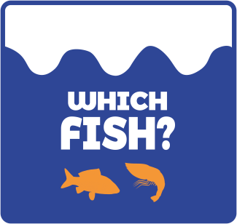

The Albatross and the Fisherman: a colouring book
Story by Gabriella-Aikaterina Dallas
Illustration by Nick Massios
for the WhichFish Campaign

Slide 2
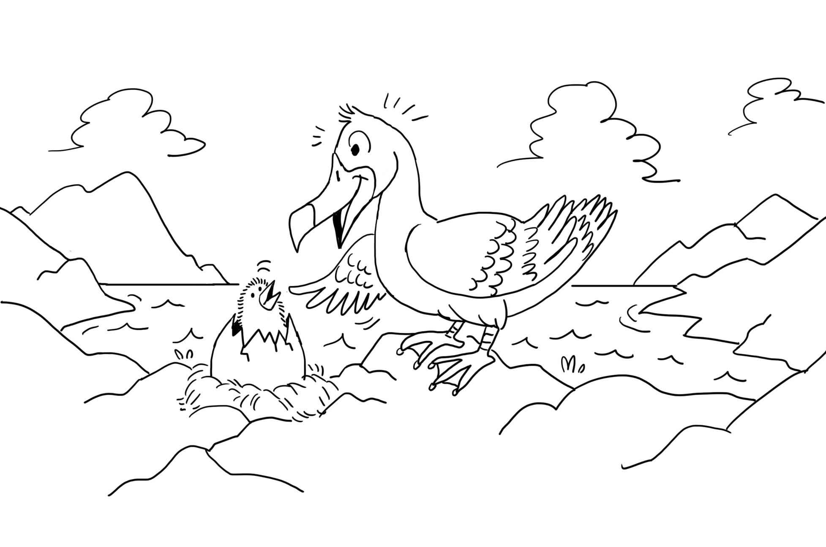
Up in the northern seas, lived an albatross. Let’s say his name was Bob. Bob had a big challenge. His chick had just hatched, and as we know, all babies are hungry when they are born. Seabirds may be long-lived but the first years of their lives hold many dangers.

Slide 3
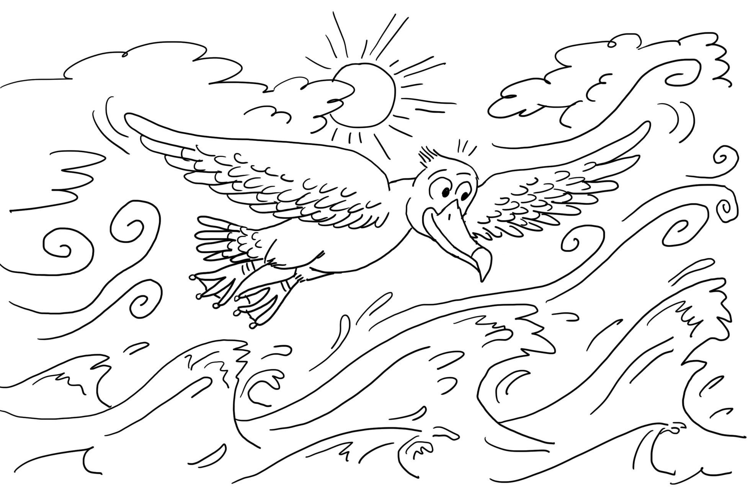
The waves were enormously high and the wind was pushing him, helping him soar away from the sea surface as the sun was playing games with the clouds. Bob’s feathers fortunately could keep him dry in the rough weather, and high up, as his wingspan was close to four meters.

Slide 4
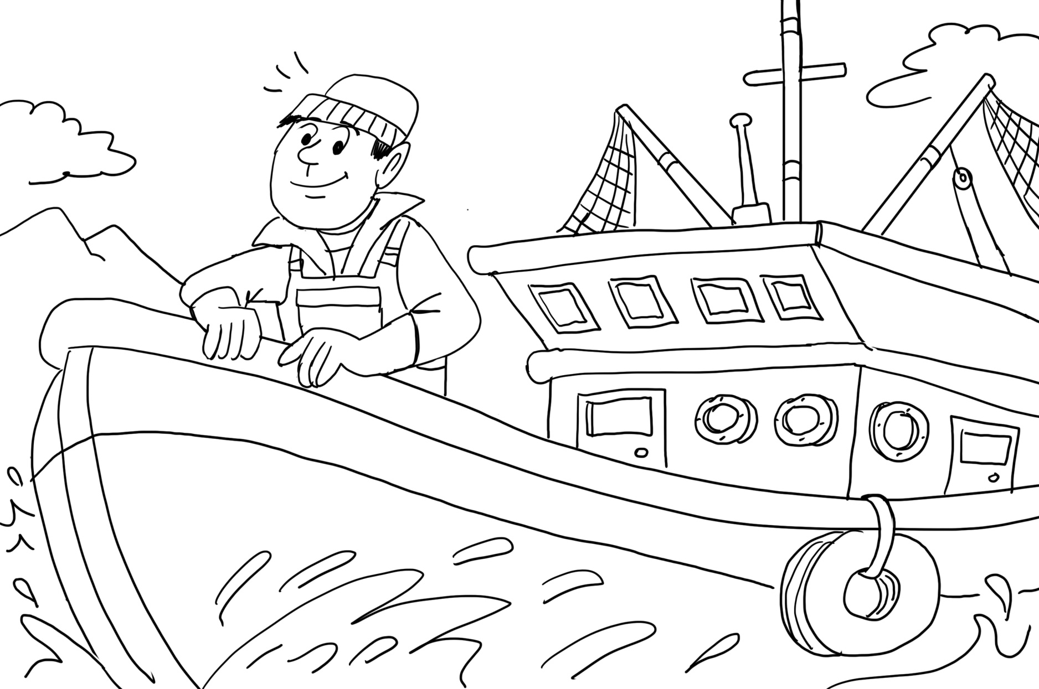
Mark, the fisherman, would go offshore with his crew for months at a time to fish.
His challenge was to fill all his fishing boat’s cellars and freezers.
Both Mark and Bob had the same goal, to provide for their family.

Slide 5
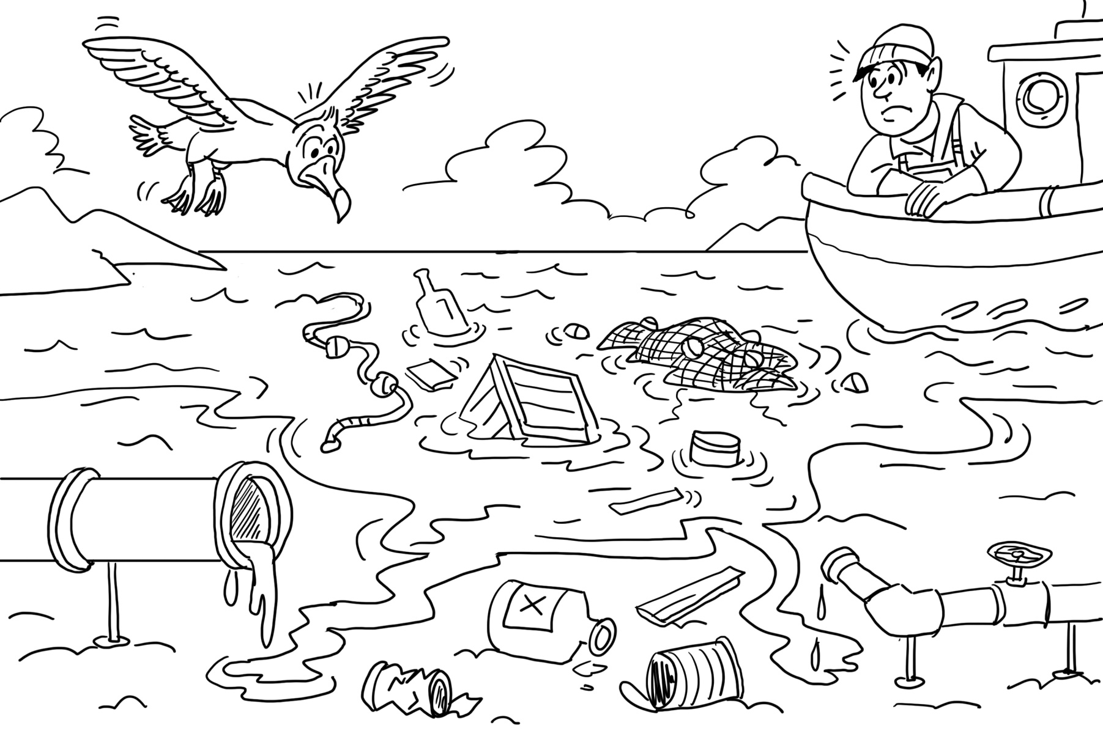
Back at the sea shore, there wasn’t much fish to catch, as the coastline population and sea traffic made it hard for both sea birds and fishermen alike. Discarded fishing gear and industrial waste made it even harder. The seemingly vast sea is only average for Bob’s meal catch. The same holds for Mark, as in order to load up his freezers he needs to scan the oceans to find the dwindling schools of fish.

Slide 6
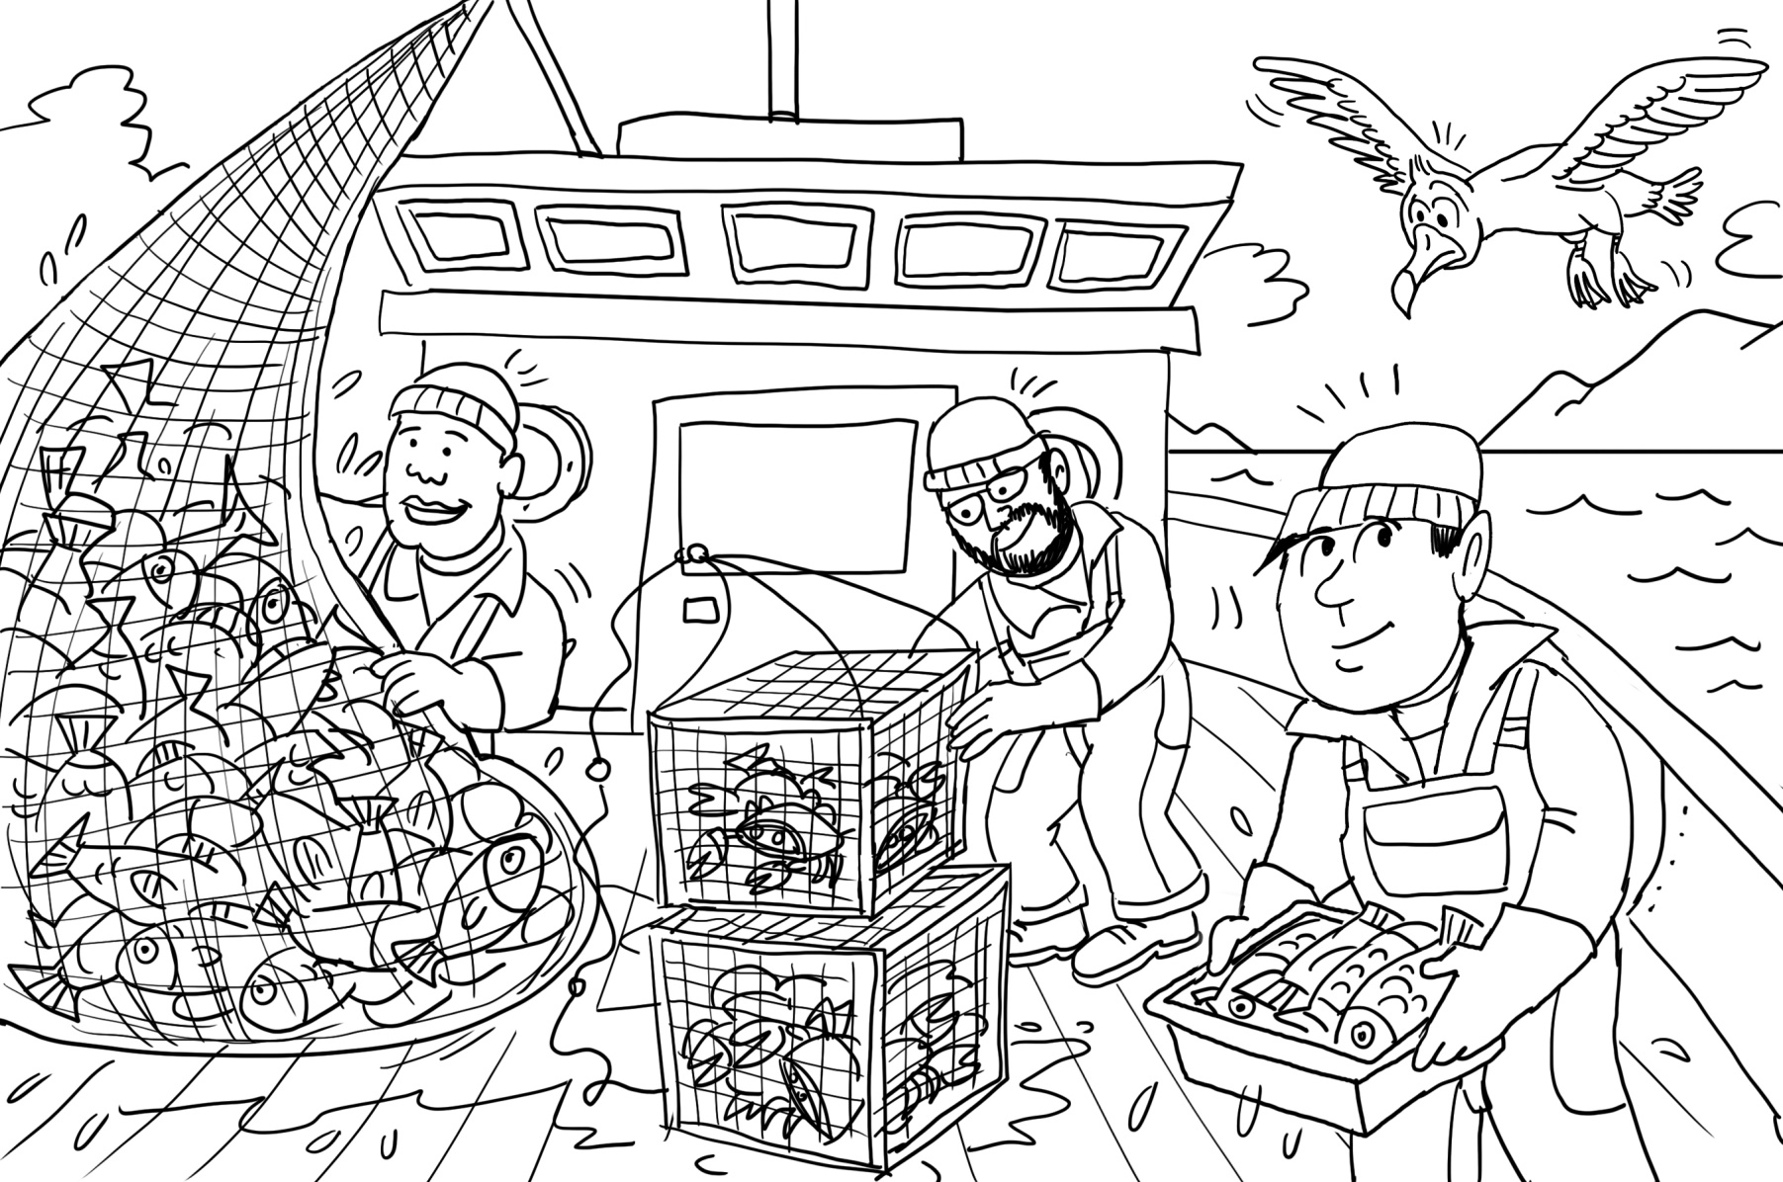
Every day Mark spotted Bob flying above and around the fishing boat. The fishing crew gathered all the nets and crab cages on the stern and bow ensuring nothing was left out of the cellars. Using their specialized nets, there was very little fish left over for any seabirds like Bob who every day returned back to his rocky cliffs with almost nothing in his beak for his chick. He flew every day back to the fishing area navigating amidst the tallest waves in hope he would get some food.

Slide 7
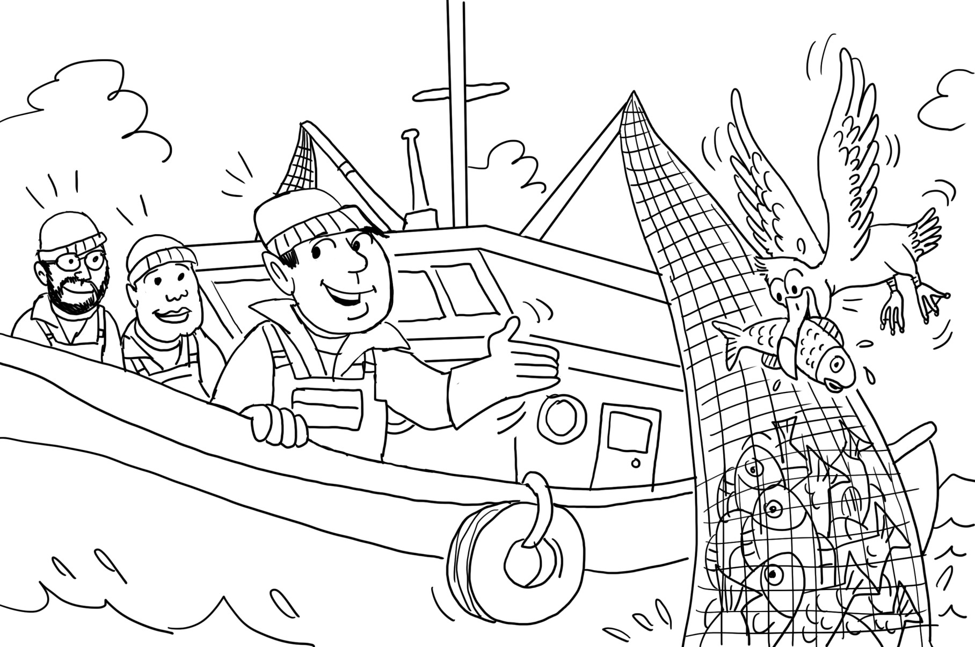
After weeks of successful hunting, Mark saw that the boat’s cellars were full. On the last day of his fishing season, he left the catch for hungry seabirds to take as many fish as they could back to their nests. The fisherman turned to his crew “When you provide in gratitude, to those that belong to your natural surroundings, they also provide for you. If we focus on what is good for all life, then the generations ahead will never be in danger.”

Slide 8
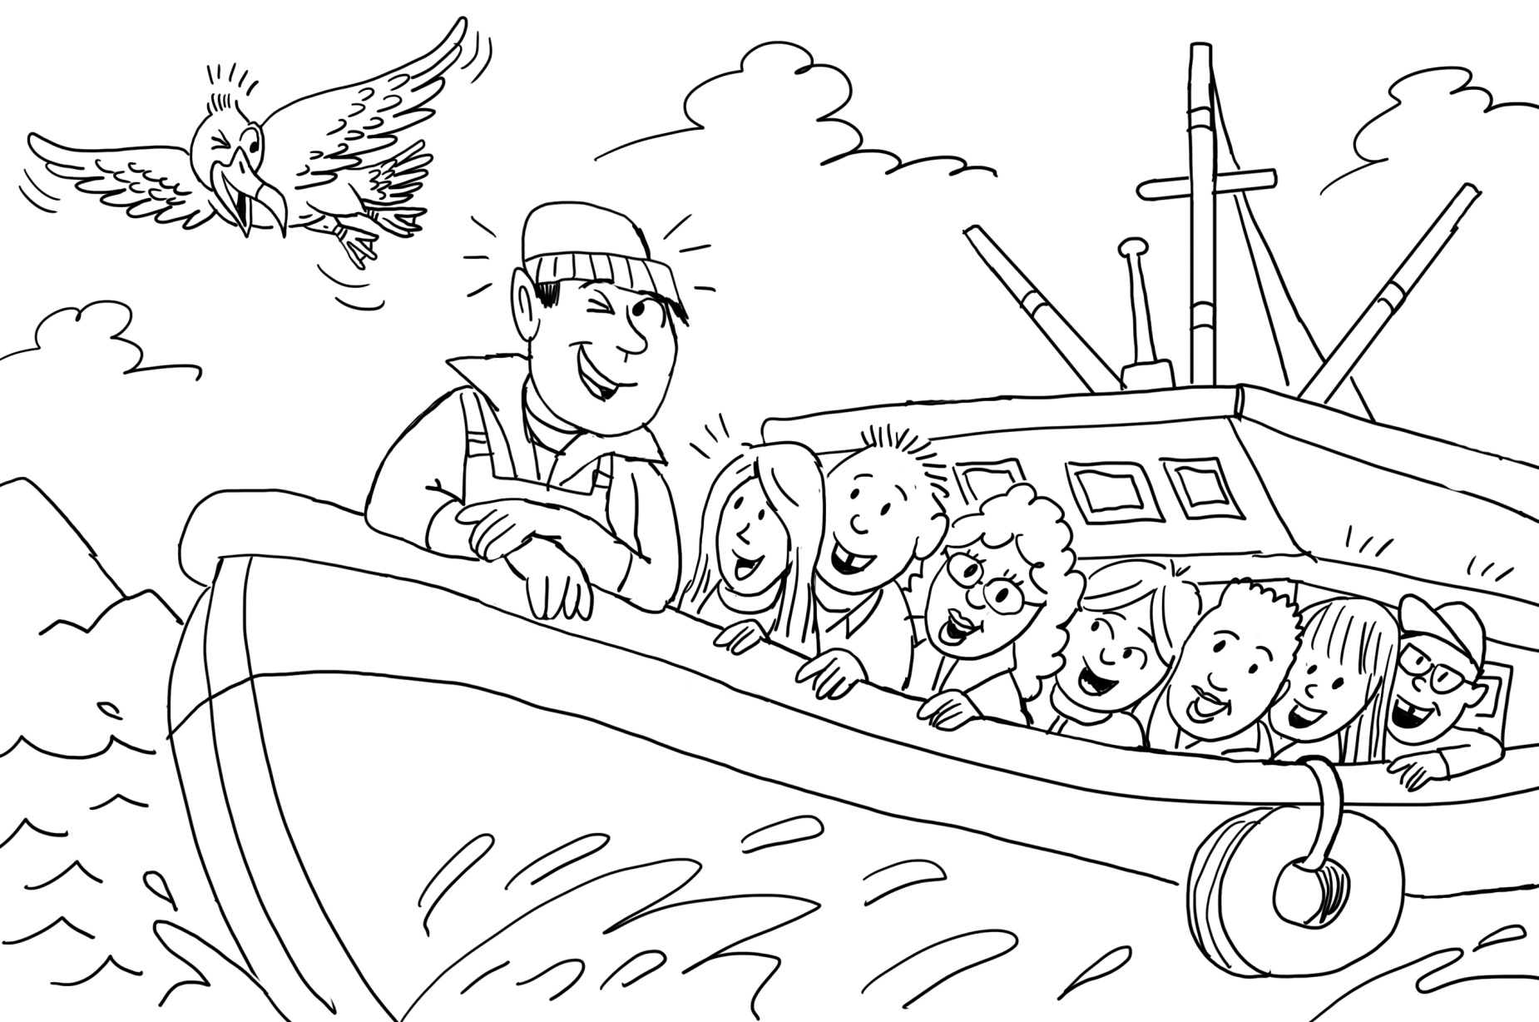
But that wasn’t enough for Mark. He had a great idea for the years to come and generations to follow. He started arranging mini-tours with his fishing boat, for school-kids, friends and families, even tourists from abroad. So they would meet and experience the vast northern seas and their marine ecosystems.

Slide 9
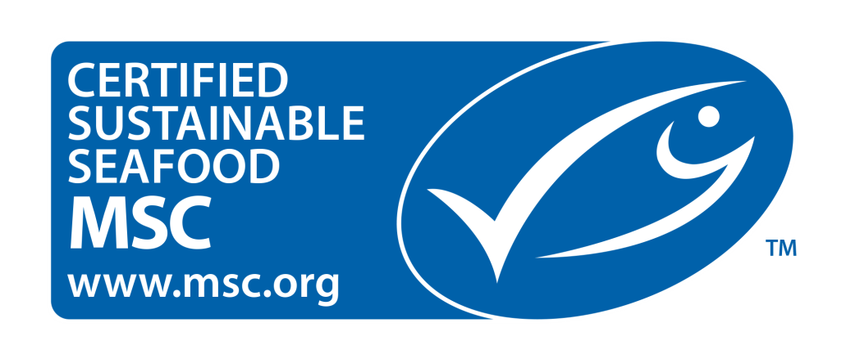
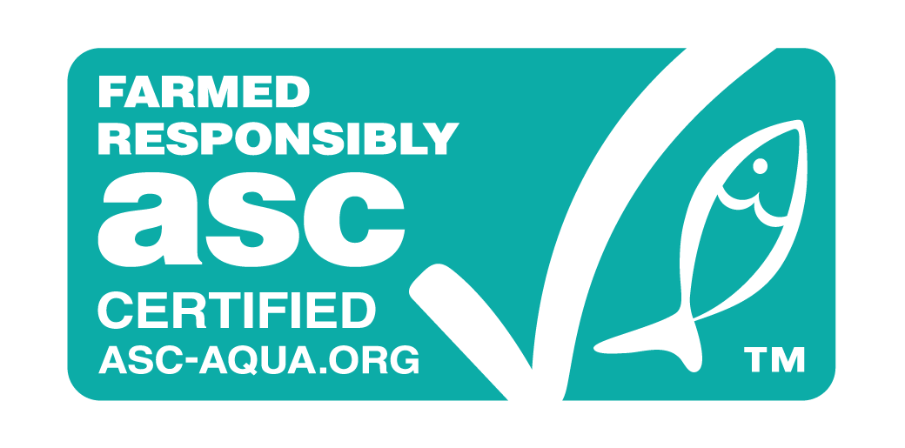
Mark, the fisherman, as we might understand, cared about wildlife. He represents small scale fisheries that have an opportunity to change the industry for the better.
You, as a consumer, can also show you care by choosing fish that have been sustainably sourced and labelled. Good labelling is really important for the protection of sea life and for maintaining a balanced food chain for everyone…
… because Bob and Mark, you and me, we all have a chance of co-existing within our natural global surroundings, indefinitely.

Slide 10

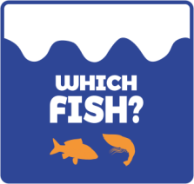

…for the WhichFish Campaign
This story was created in support of the WhichFish Campaign, which aims to influence consumers to choose sustainably sourced fish and help protect our oceans and its dependents.
Ms Gabriella-Aikaterina Dallas is a Youth Service Learning Program student at the Attica Zoological Park and has the wonderful gift of storytelling. She was mentored by Dr Georgina Spyres, Head of Education & Research, for this project.
Mr Nick Massios is a graphic designer and cartoonist based in New York. He kindly agreed to illustrate Gabriella’s story pro bono for the purposes of the WhichFish campaign.
For further information on the Service Learning Program for Youth visit our website here!
For further information on the WhichFish Campaign click here!

